Slide 1
Sugon HPC: Gridview 3.0
Moscow, 12/2015

Slide 2


Slide 3


New Upgrade
Ultimate Experience
Faster、Smarter、Flexible
New Generation of Cluster Operating System

Slide 4
Agenda
1
Software Overview
2
Monitoring & Management System
3
Job Scheduling System
Notes:
先讲整个IT行业的大背景

Slide 5
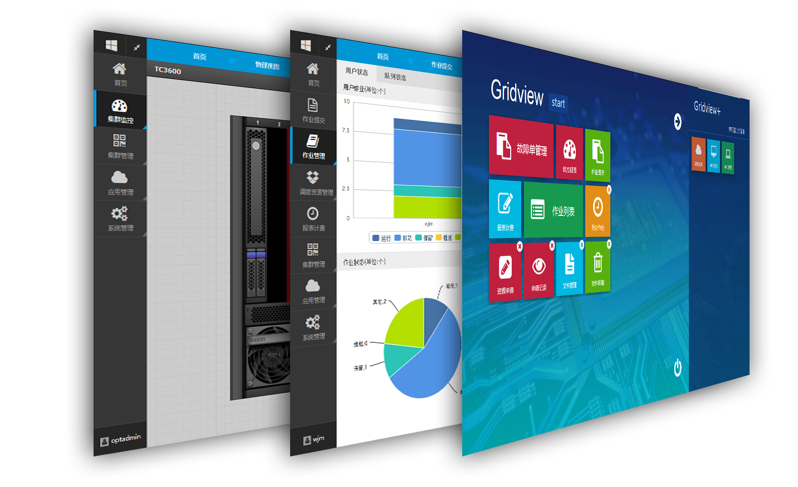
New flat design
Clear and concise interface
Elaborate functional processes
More easy to use
Conform to user habits

Slide 6
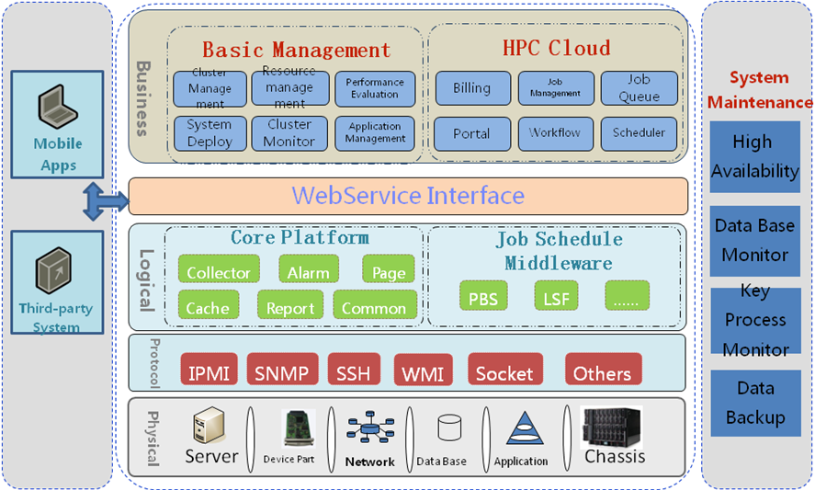
Logic Architecture
Notes:
这是Gridview逻辑架构，按照物理层，接入层、逻辑层，业务层分层设计，以提高系统的可扩展性。
业务层分为监控管理平台和HPC云平台。监控管理平台提供集群管理、资源管理、性能评测、系统部署、集群监控等运维管理的功能。
HPC云平台在监控平台基础上，为用户提供定制云平台定制的用户应用和作业管理、计费管理Portal管理、申请审批管理、调度器管理。

Slide 7
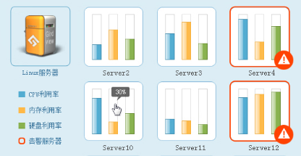
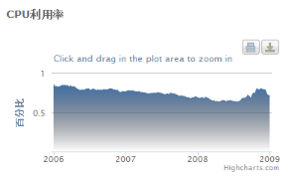


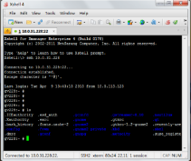
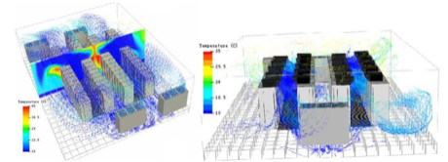

Brief Functions of Gridview
HPC Basic Software
Perform & Warning
Cluster Status
Admin
API
Manage
Data
Analysis
Report
Engine
App.
Cluster
Deploy
Tools
Moniter
Server
Network
Perfor-
mance
Analysis
Portal
Submit
Job
Res.
Apply
Warning
Filter
Analysis
Storage
Infrastructure
Queue
Accounting
Billing
Job
Monitoring
Policy
Managee
Power
普通用户

Slide 8
Comparison – Cluster Management
Function | Gridview | Platform Cluster Manager | PBS Compute Manager | Insupr Effiscale | Huawei WisdomC+
Infrastructure | Yes | Yes | Yes | Yes | Yes
Multi-OS Monitoring | Yes | Yes | Yes | Yes
GPU、MIC | Yes | Yes | Yes | Yes | No
Remote PowerOn/Off | Yes | No | No | Yes | No
Multi Warning | Yes | Yes | Yes | Yes | Yes
Remote Desktop | Yes | Yes | Yes | Yes | No
IB Monitoring | Yes | No | No | Yes | No
iKVM | Yes | No | No | No | No
IPMI | Yes | No | No | Yes | Yes
OS Deplyment | Yes | No | No | Yes | Yes
Software | Yes | No | No | Yes | Yes
Perform. Evaluation | Yes | No | No | No | No
Mobile App. | Yes | No | No | Yes | No
Backup | No | No | No | Yes | Yes
API | Yes | No | No | No | Yes

Slide 9
Comparison – Job Scheduler
Functions | Sugon Gridview | Platform LSF | Altair PBS Pro | Inspur Effiscale | Huawei WisdomC+
File Management | Yes | No | No | No | No
User Management | Yes | Yes | Yes | Yes | Yes
One-click deploy | Yes | No | No | No | No
Job scheduler | Yes | Yes | Yes | Yes | Yes
Application Templete | Yes | Yes | Yes | Yes | Yes
GPU Scheduling | Yes | Yes | Yes | Yes | No
VNC | Yes | Yes | Yes | No | No
Jobs Report | Yes | Yes | Yes | Yes | Yes
Breakpoint continuation | Yes | Yes | Yes | No | No
Customers | More | More | Less | Less | Rare
Critical Case | Yes | Yes | No | No | No
Customizated | Yes

Slide 10
Agenda
1
Software Overview
1
Monitoring & Management System
3
Job Scheduling System
Notes:
先讲整个IT行业的大背景

Slide 11
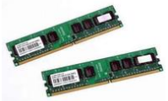
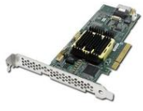
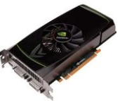

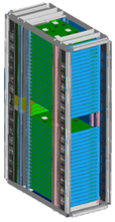
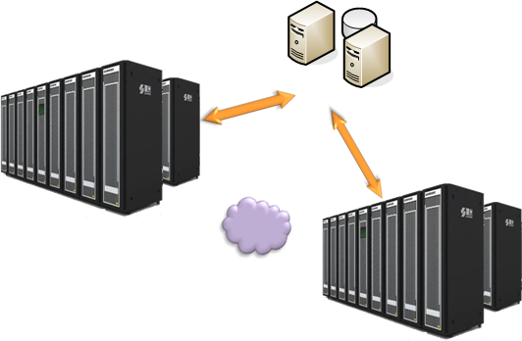
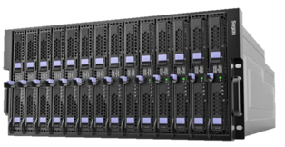
Multi level Monitoring & Management
Parts Level: Processor, Memory, Hard disk, GPU, network adaptor
Node level management
Deploy mode：single or Cluster
System level expansion: Chassis, Cabinet
Cluster level: multiple cluster
multi-layer mode deploy

Slide 12





Distributed System: Large Scale Deployment
Clients
Clients
Central Manage Node
DB
Clients
Clients
Agent: 1
Agent: n
Partition Manage Node
Partition Manage Node
Distributed IT Resource
1
N
1
N
Shared
Res.
Shared
Resource
Partition1
2
Partition N
2

Slide 13
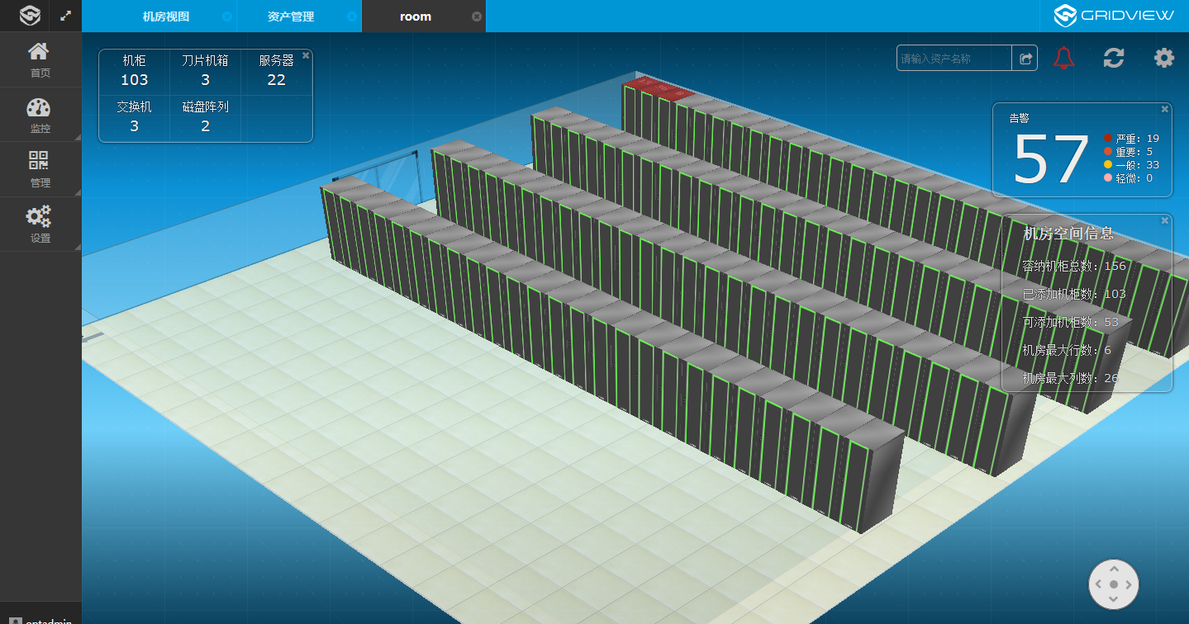
3D Infrastructure Monitoring

Slide 14
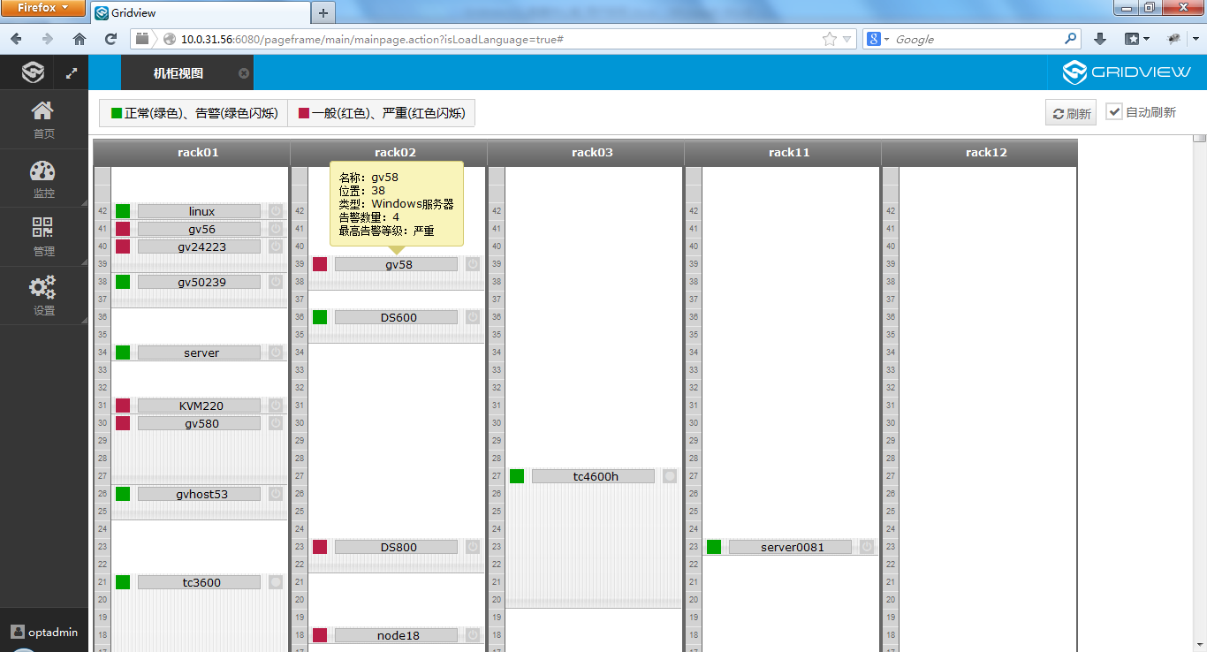
As view as Configure

Slide 15
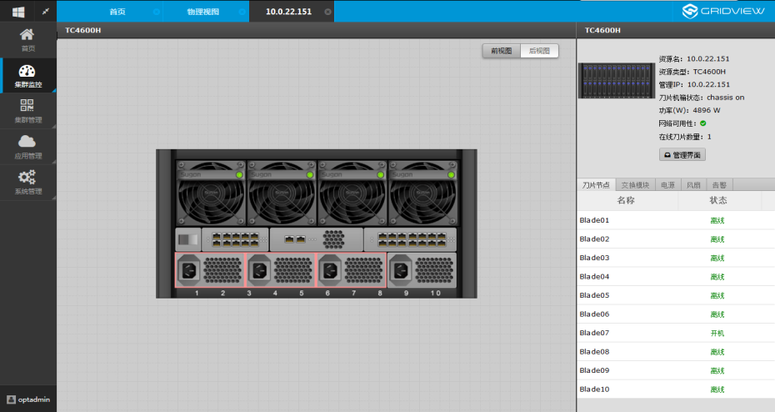
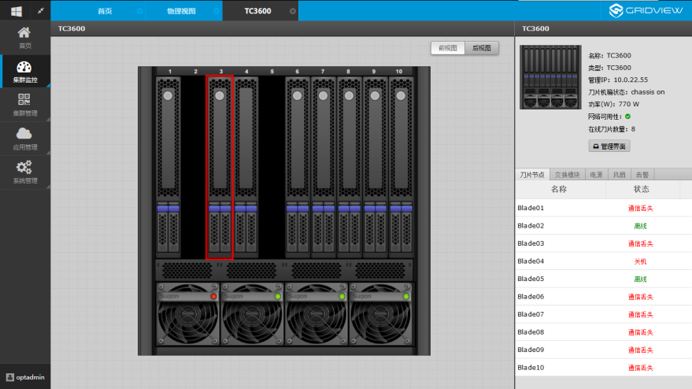
Chassis View

Slide 16
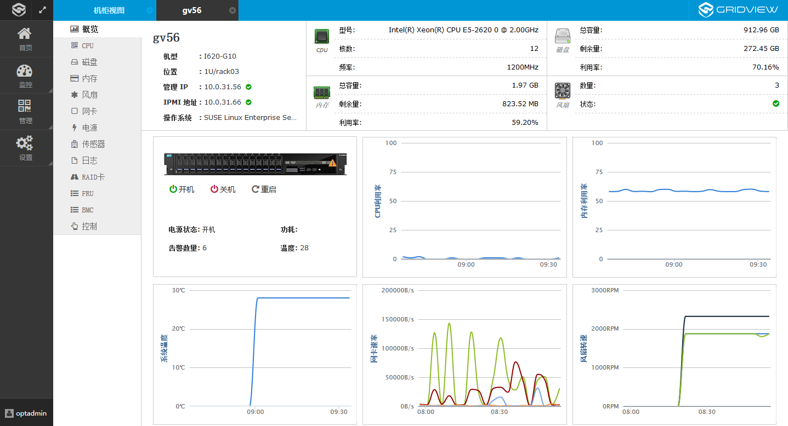
System Monitoring
Tens of parts, 150 indexes, useful toolkits

Slide 17
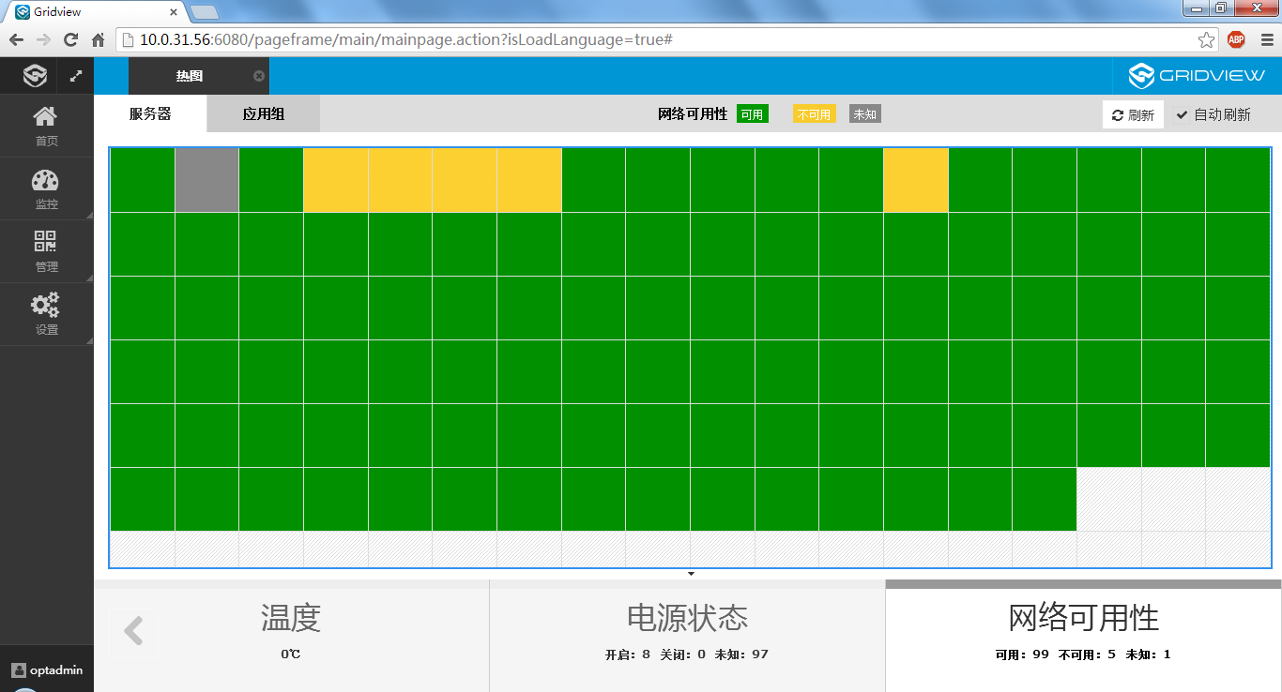
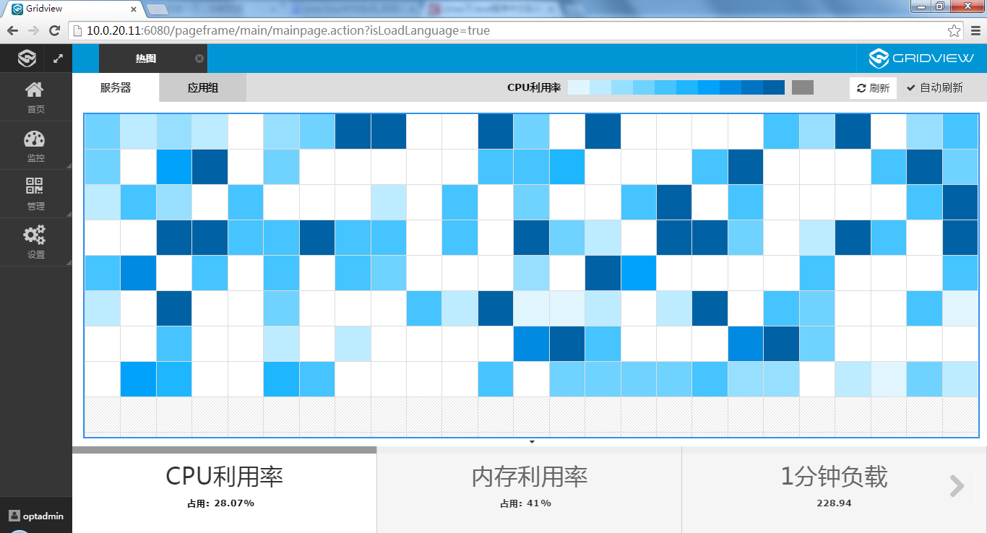
Performance overview

Slide 18
Field
Level
Mode
Relation
Range
Analysis
Warning Policy
Bussiness
Multi
level threshold……
Emerge
Email
SMS
App.
Account
Admin
……
Relation
Analysis
Import
Minor
Application
Warning
Normal
Device

Slide 19
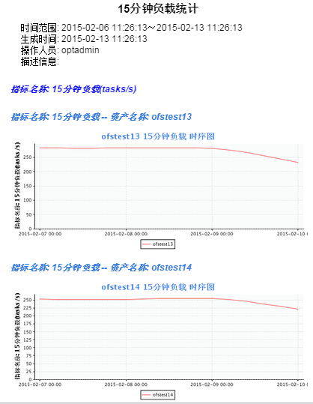
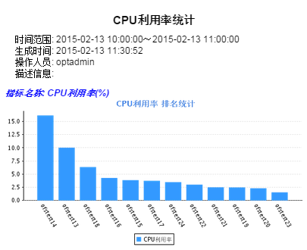
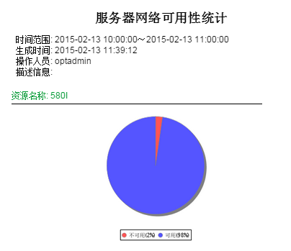
Monitoring Report
Multiple Index
Multiple Diagram

Slide 20








Cluster Management
User management
  Supports local users and user management based on NIS, LDAP, AD;
  The transaction control can be carried out when the multi users are operated simultaneously.
Multi system deployment
  Support for the deployment of the operating system image and optical disc image
  Support user defined kernel deployment system
Fast configuration cluster
  Achieve a key to optimize the cluster configuration
  Can choose the configuration options, such as a key configuration system services, etc.
  Key file automatically by the management node to calculate the node synchronization
Centralized and out of band management
  Multi node supports remote switch machine through IPMI, and can advance the order of different roles in different roles.
  IPMI through the KVM to achieve focus on the management of cluster
OS
Account
Software
Application
Remote
20
Notes:
20

Slide 21
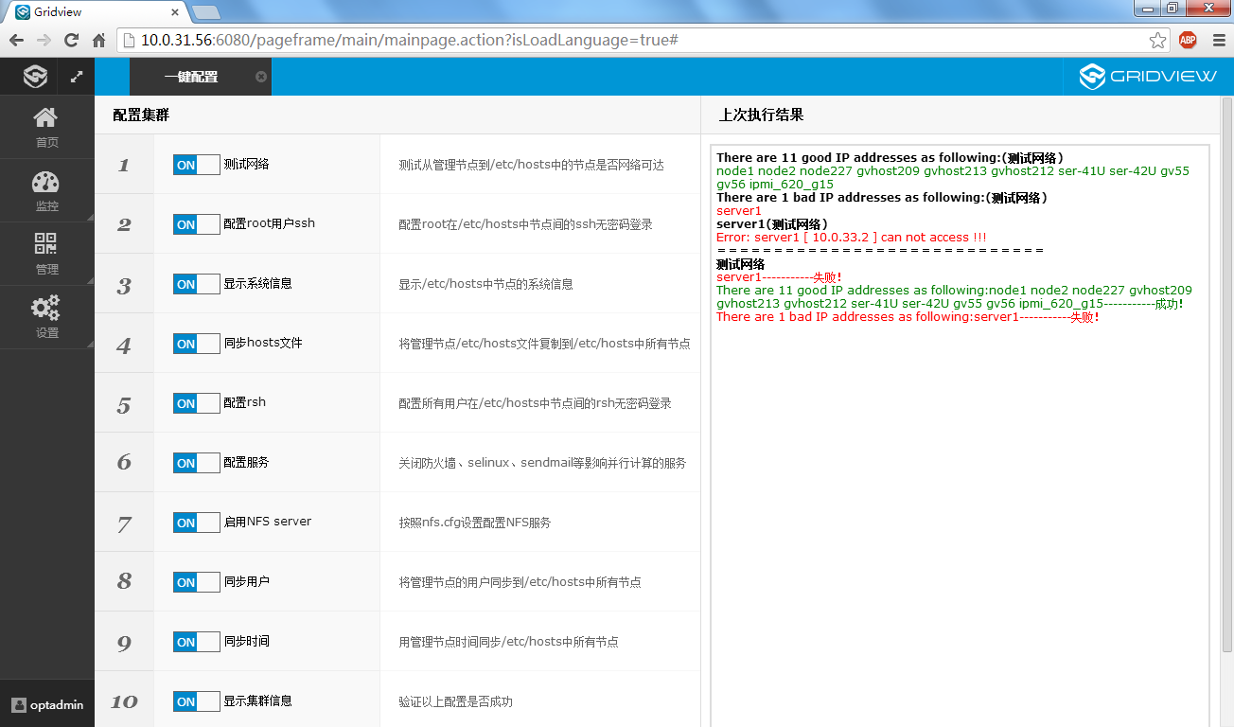
One-click deployment
Ready: SSH、Hosts、RSH、NFS、Accounts、Time

Slide 22
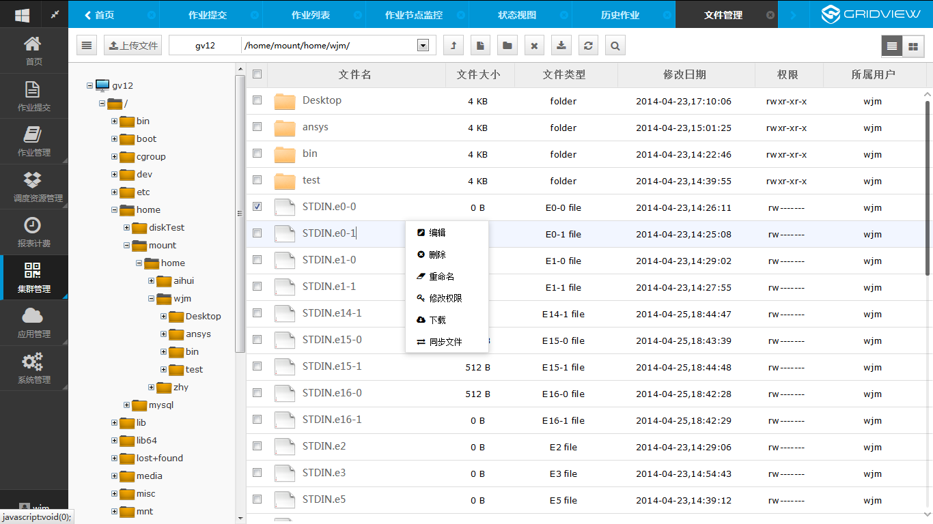
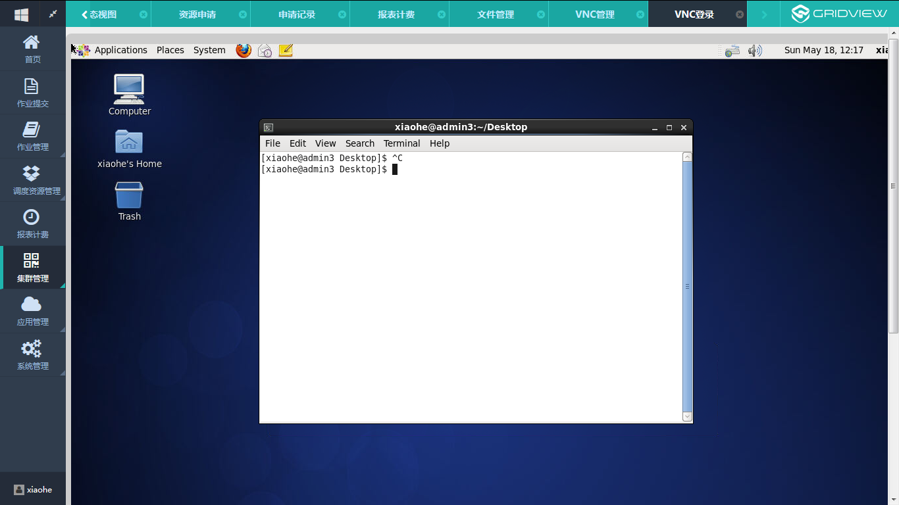
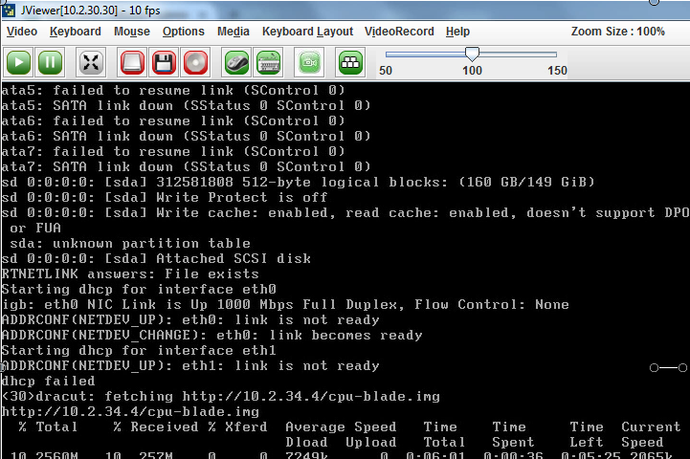

Toolkits
Batch switch machine
Parallel command
Quota management
Process management
File management
VNC management

Slide 23





IPMI Off-band Management
Support IPMI1.5 and IPMI2.0 Protocols
Hardware Sensors
Events and Warning
Motherboard Information
Temperature
Abnormal
Voltage
Fan
Alert Notice

Slide 24

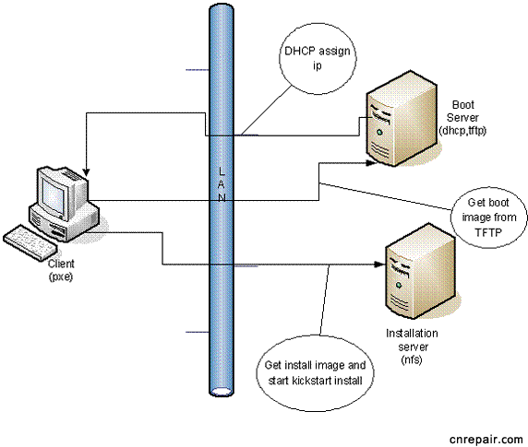
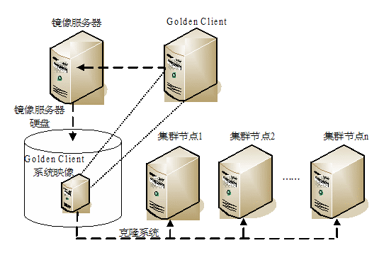

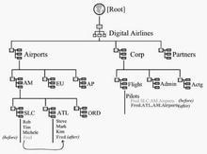
Multiple Deployment Mode
kickstart
Node mirror
Image mirror
(Support autoyast、kickstart）
AutoYast

Slide 25
Agenda
1
System Overview
2
Monitoring & Management System
3
Job Scheduling System
Notes:
先讲整个IT行业的大背景

Slide 26
Scheduling Management Middleware
Scheduling core: to provide specific job scheduling and management functions of the specific job scheduling system, such as PBS.
Scheduling management middleware: provides a unified scheduling system for the management interface (such as job management), as well as the core of the different scheduling interface implementation (that is, the adapter).
Operator Portal: a variety of roles (common users, operation and maintenance administrators, operators) of the user's access to the HPC cloud platform.
Notes:
Gridview提供一个调度管理中间件，屏蔽不同硬件和调度核心的差异，实现异构资源的统一调度和管理，提高整体利用率和作业吞吐量；统一管理策略，提高管理效率。

Slide 27
Scheduling Policy
Priority strategy (Priority Job)
  According to the static state of the job and the system state, the scheduling priority of the job is calculated by the comprehensive index. Static attributes include the user (Group), the queue, job type, QOS, resource request, etc. the dynamic attributes include the number of users in the number of jobs, the occupancy of the number of cores, the amount of memory occupied, the number of failures, etc..
Node assignment strategy (NodeAllocationPolicy)
  Supports a variety of node allocation strategies, such as CPULOAD (load), FIRSTAVAILABLE (in order), LASTAVAILABLE (in order), PRIORITY (by flexible configuration of priority), MINRESOURCE (minimum matching), MAXBALANCE (node equilibrium), FASTEST (processor speed), etc.
Reservation backfill strategy (Reservation)
  Reservation strategy can reserve the available resources for certain users or groups in the future. It can guarantee certain (users) urgent tasks to be processed in time. The backfill strategy can be used to improve the throughput of the system without affecting the high priority.
Preemption strategy (Preemption)
  Allows high priority jobs to be executed immediately, even without prior reservation, to replace other running low priority jobs. After the high priority, low priority operation can resume and continue to run.Fair allocation strategy (Fairshare)You can adjust the job priority level dynamically according to the current user and user groups to achieve the use requirements they allow.

Slide 28



GPU/MIC Resource Scheduling
Function：
Automatic detect GPU & MIC
Arrange suitable numbers of Processor for the jobs
Scheduling the jobs according according the key index of the policy
Results：
Increase the utilization of resource
Accelerate the performance
Optimize of mixture circumstance, unique management
  Selection the suitable GPU/MIC
Gridview Schedulor
Manage the workload
Inquiry the resource, policy
TORQUE
Automatic detect, Avialiability of accelerators, Key index of the policy
Resource
Xeon
Phi
GPU
Core
Workload
Memory
…
Temp
Failure
Memory
…
*

Slide 29
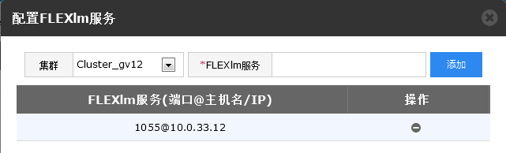
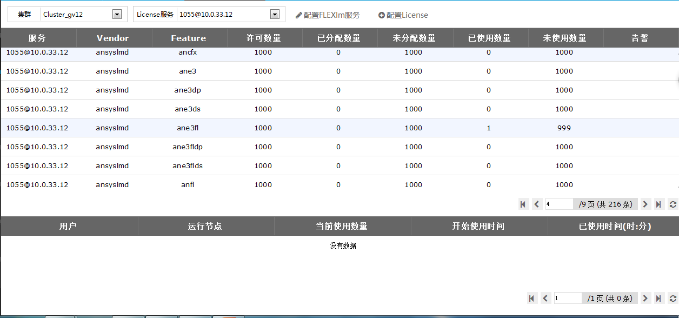
FLEXlm Support
  Multiple FLEXlm Servers
  Query realtime status of license usage
  Query Relative users information & jobs

Slide 30
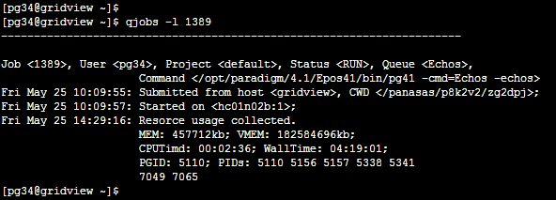
LSF Compatible CLI
bjobs – 作业查询命令
bsub – 作业提交命令
bkill – 作业控制命令
bqueues – 队列查询命令
bhosts - 节点查询命令
bhist – 历史作业查询

Slide 31
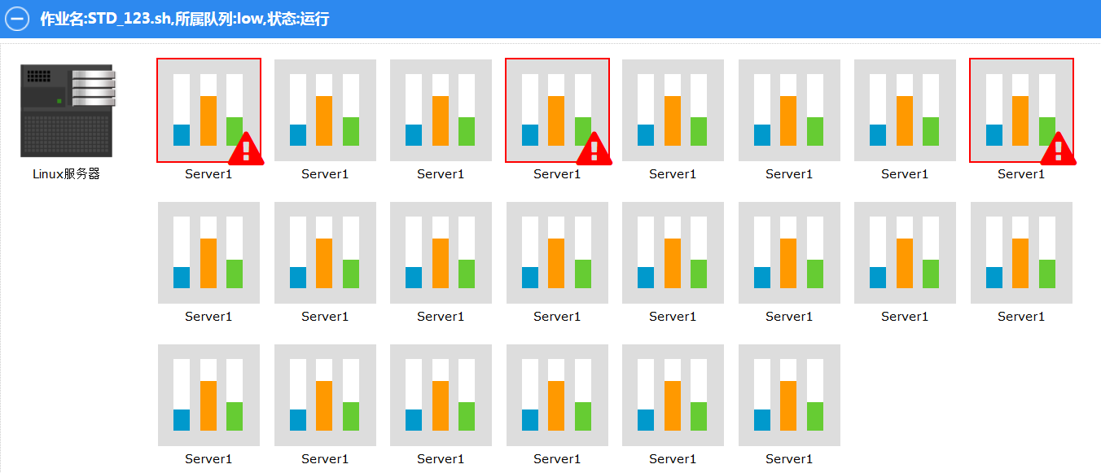
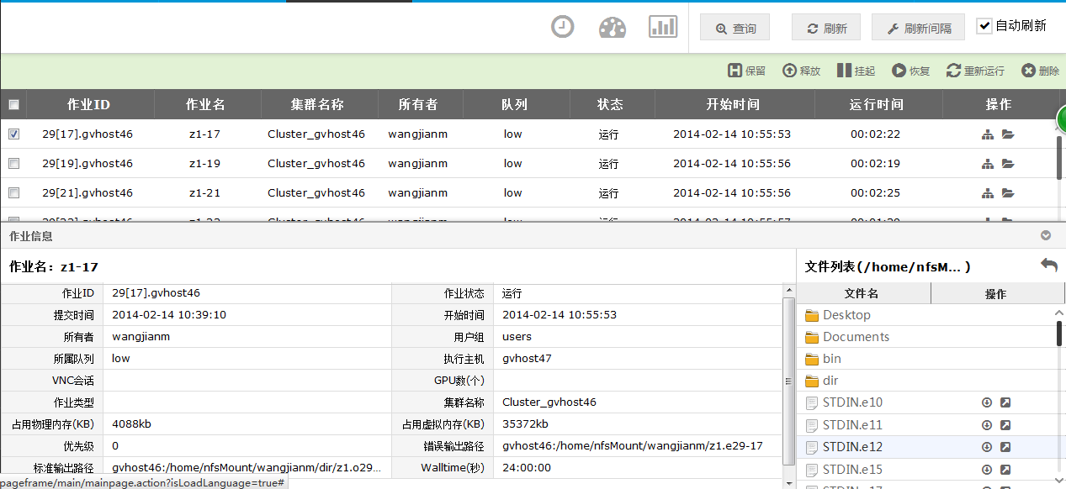
Job Monitoring
Notes:
提供了丰富的作业控制操作，包括关联的文件操作（在线查看、打包下载），以及作业服务器状态的监控。

Slide 32
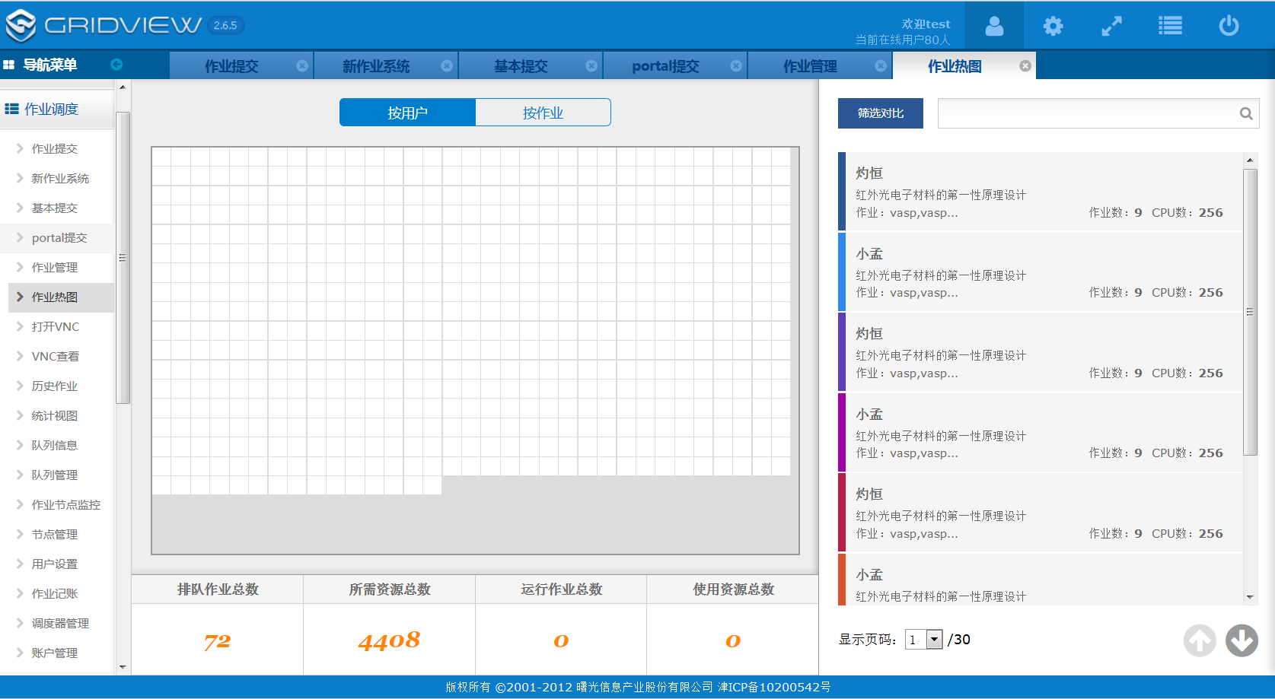
Jobs Distribution Diagram

Slide 33
Pre-authorization and billing process
set the user's machine time quota (pre recharge) and rate setting
Users submit the job
According to the type of resources required to make an inquiry
If the quota is sufficient, make the pre authorization
Jobs start
After jobs end, statistical actual usage
Revocation of pre authorization, and real-time deduction
0
计费系统
6
3
资源调度器
2
4
资源管理器(Gridview, PBS, LL, LSF)
预授权
1
实时计费
用户配额(预充值)
询价
预授权
5

Slide 34
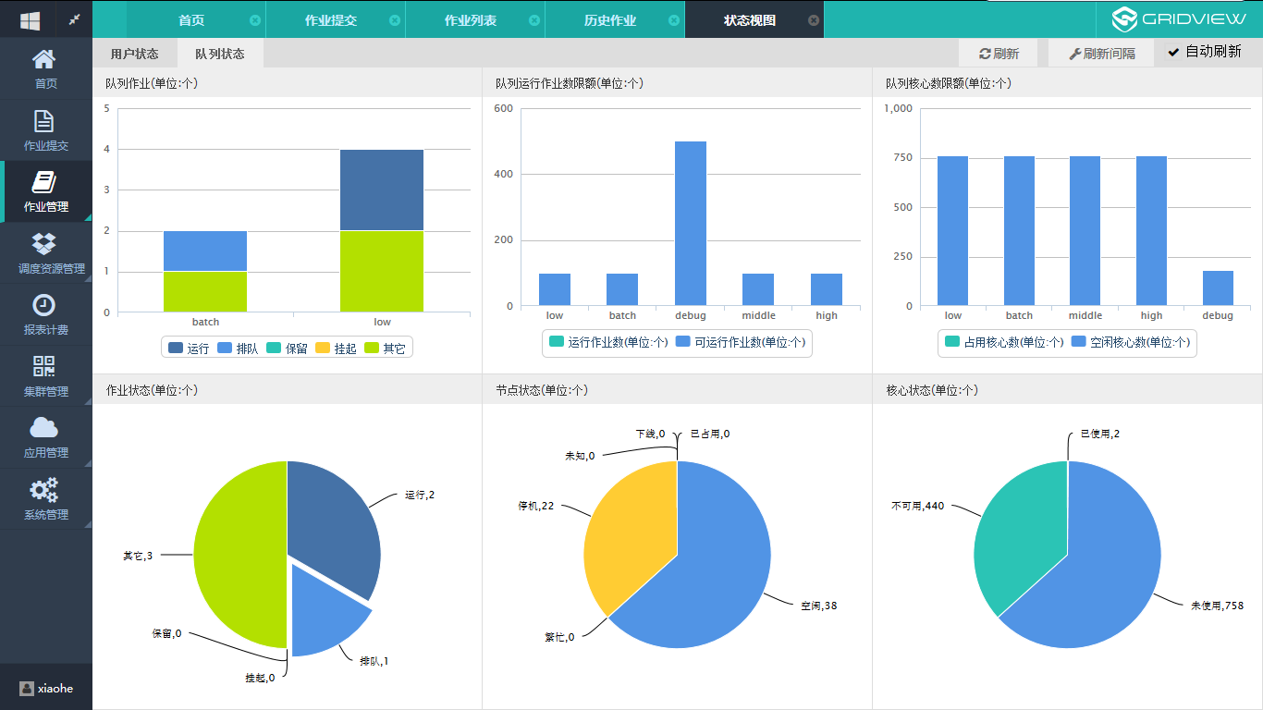

Individual View
Individual view
Inform users automatically when their jobs were done or failure by email or SMS
My yellowpage
My Space
Media Center
Most popular functions
User defined sections
Resource Apply
Account Report
Status of Resource and Jobs
Report
Information
Warnings
User settinig

Slide 35
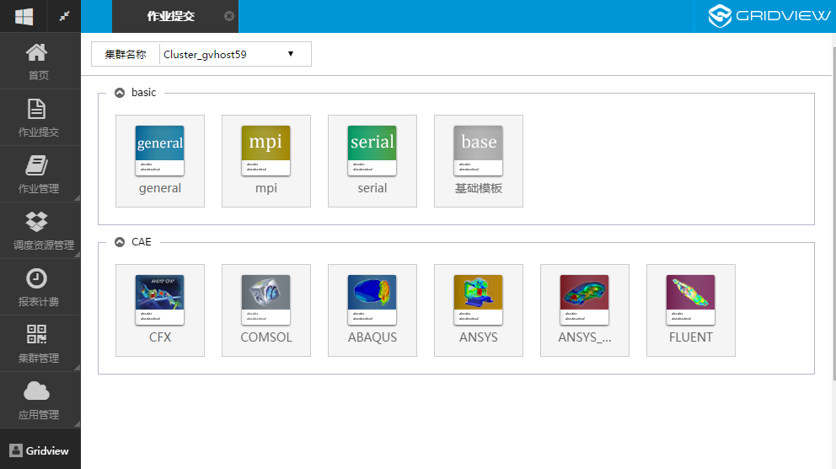
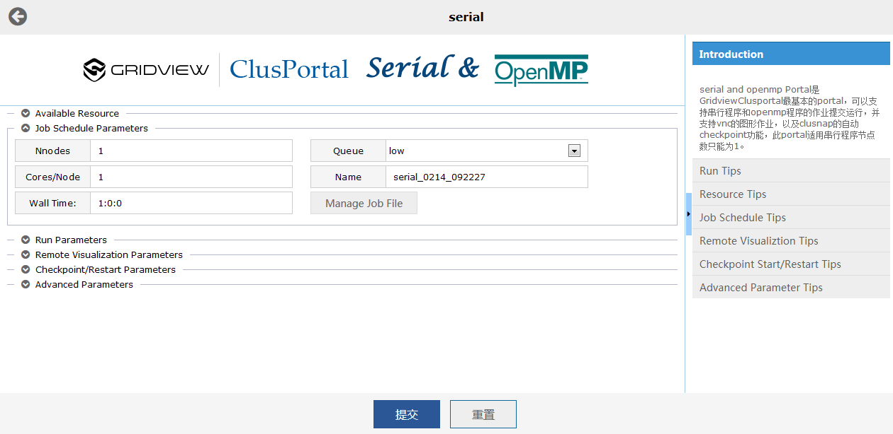
Application Portals
BASIC
MPI
Serial
General
CAE
ABAQUS
ANSYS
CFX
CFD++
COMSOL
FLUENT
NASTRAN
FECO
HFSS
FEKO
WORKBENCH
QM
VASP
MATH
MATLAB
MAPLE
MAGMA
MATHEMATICA

Slide 36
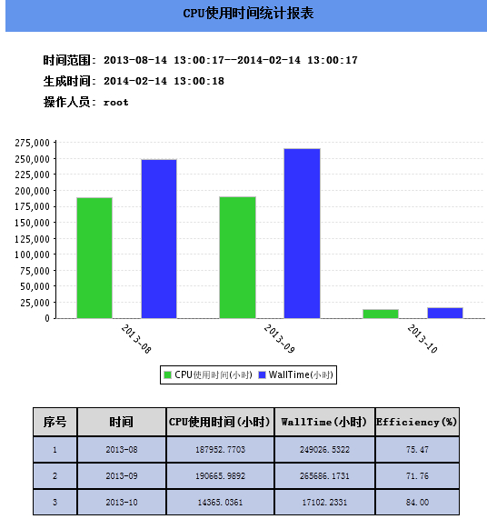
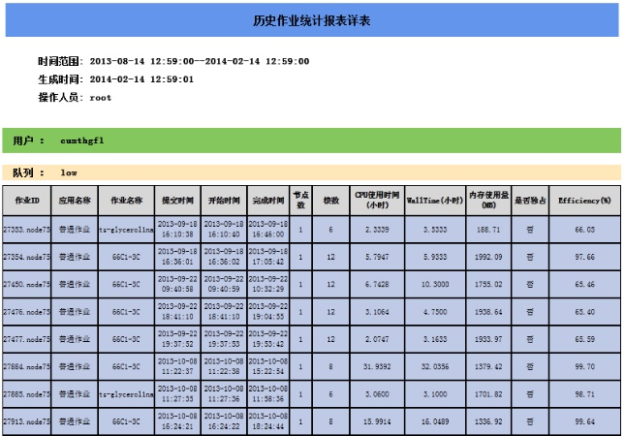
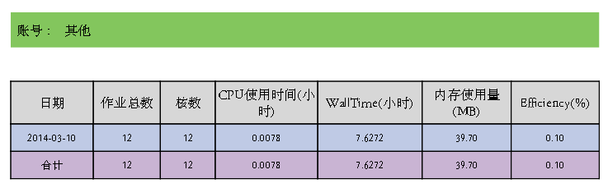
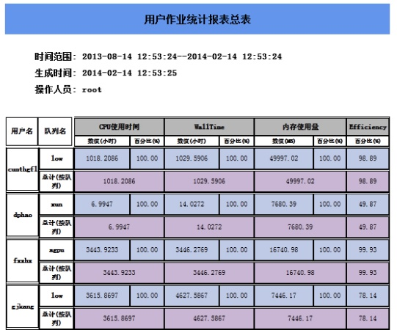
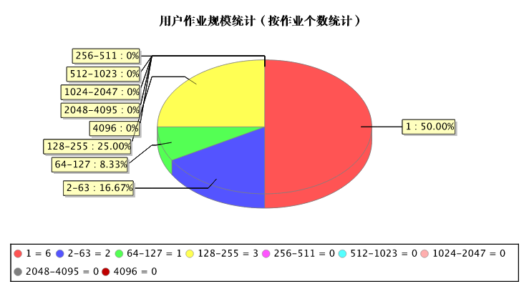
Job statistics report
Predefined Report
  User job statistics
  Node usage statistics
  Application operation statistics
  Historical statistics
  Account assignment statistics
  CPU using time statistics
  User activity scale statistics
Supports predefined and custom time filtering conditions
Support PDF, Excel, HTML format export

Slide 37
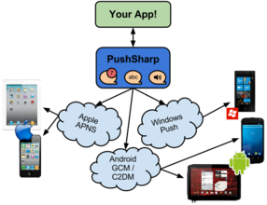
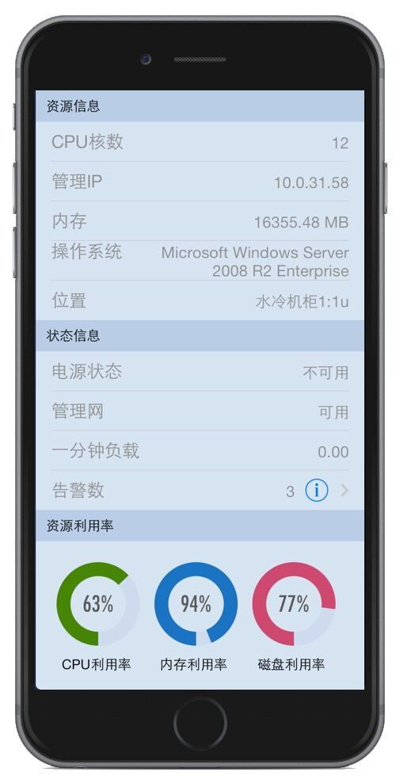
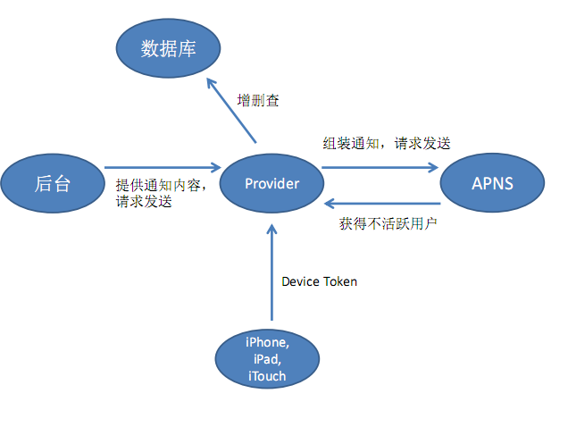
SMS Push
Use PushSharp to set up a message push center in the cloud, for the iOS, Android and other mainstream mobile smart mobile platform to achieve message push function.

Slide 38









Gridview Successful Stories

Slide 39
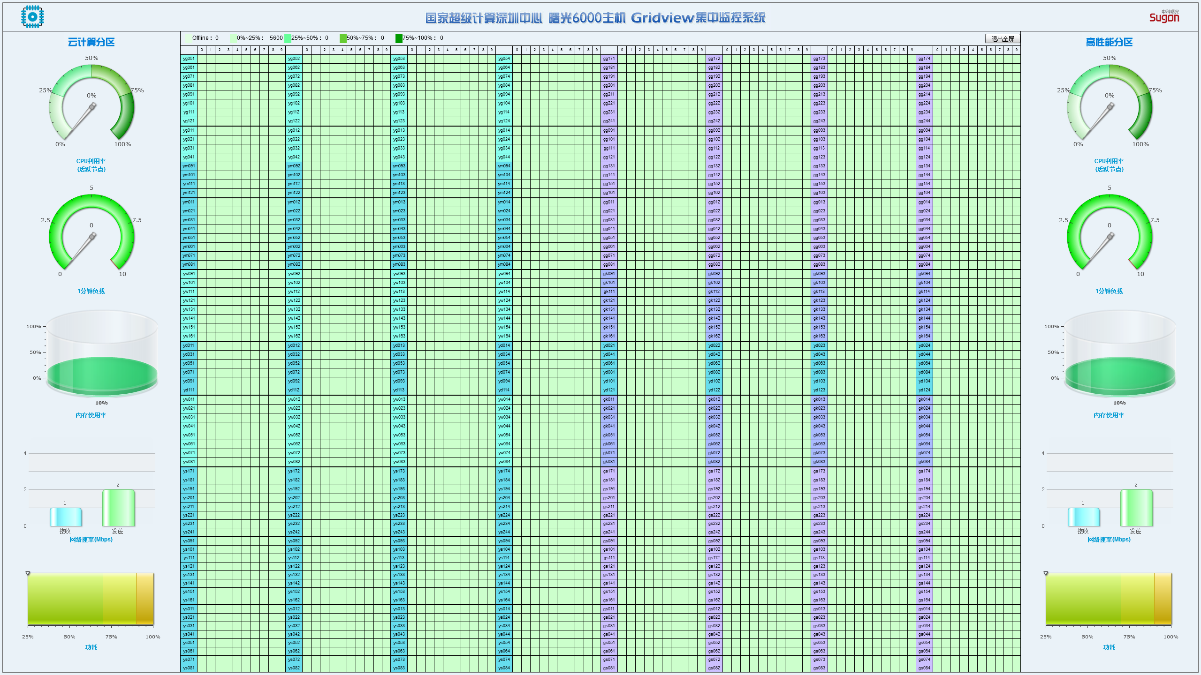
Sugon Nebula System

Slide 40
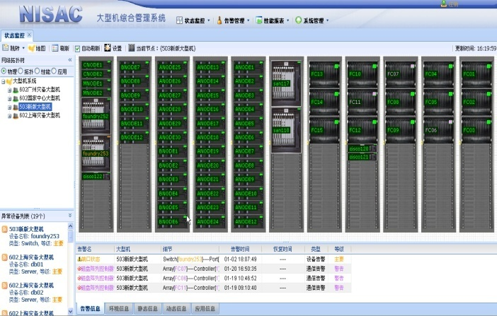
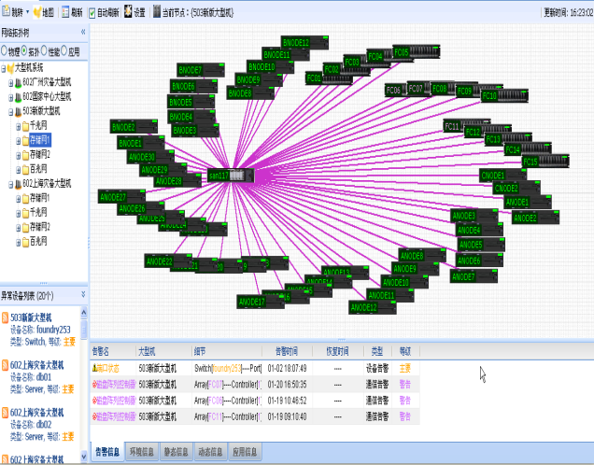
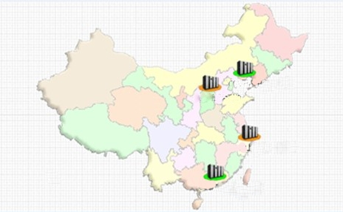


Distributed System Case
Cabinet View
Network topology
Distribution View
Performance Analysis
Applications View

Slide 41




State Grid Customization
Fast integration of power simulation software based on template specification
Provide WebService interface, and other software system interaction
Notes:
Adaptive Computing套装

Slide 42



Xijiang Oil Field
The application of Paradigm and other applications to scheduling system
Support for partition setup, multi-level preemption and other management strategies
Supports interactive submission and graphics forwarding
Fault detection based on application (non system), automatic removal and recovery of nodes
Notes:
Adaptive Computing套装

Slide 43






HPC Cloud
气象云
石油云
工业制造云
HPC Cloud
Data
Analysis
Catalog
Accounting
Billing
Authrization
Resource
Workflow
Scheduling MiddleWare

Slide 44




应用发布及订阅
配置访问方式
支持自助式服务
管理员可发布应用，并可指定具体应用的用户权限；
按需交付应用
普通用户可使用应用，并可以管理属于自己的应用；

Slide 45


Remote 3D visualization(1/2)
Interactive needs of the work, it can support real-time display and interactive operation of 3D visualization applications.
Supports Session sharing and job coordination

Slide 46




Remote 3D visualization （2/2）
可视化集成中间件
支持异构操作系统
支持在虚拟机上的 3D 加速
添加标题
可视化中间件
无缝对接，屏蔽厂商差异，以业务为导向定义方案。
Enginframe 在 Web 中操作 2D/3D 应用
开源，免费
面向虚拟桌面和应用提供高清使用体验
自适应协调
Linux 平台的 3D 应用程序
用户体验得到很大改善

Slide 47

Gridview Online Operating Center

Slide 48

Gridview Community
http://gridview.sugon.com

